Slide 1
Analysis of man-in-the-middle attacks' evasion and effectiveness against SOC tools
Aziel Orozco

Slide 2
ABstract
ANALYZE
INQUIRY
What factors affect the success of different MitM attacks evasion on red team engagements against various Security Operation Center(SOC) tools
MitM dropbox attack's and their ability to evade detection by scrutinizing their efficacy against diverse(SOC) tools
HOW
A Windows AD environment deployed alongisde Elastic Cloud's Security Information and Event Management(SIEM) capability to integrate SOC tools and over see the network, while the dropbox devices, the LAN Turtle and Raspberry Pi 4 execute MitM Attacks in the environment
GOAL
Bridge the gap between red team engagement dropbox usage and SOC tool effectiveness against the dropbox usage utilizing MitM attacks

Slide 3
introduction
Physical access and dropboxes
Physical Access is an underestimated attack vector
Ability to plant dropboxes into the network and maintain persistent access
Red team engagements
Defense through offense, emulating TTPs to better a corporation's security posture
Identify potential vulnerabilities in the internal network
Often an AD environment, where dropboxes could be planted if specified in the Rules of Engagement(RoE)
Security operation centers'
The Front lines of defense who detect and respond to any potential network breaches and anomalies in the network 24/7
Often work alongside red teamers and penetration testers in purple team engagements
MITM ATTACKS IN AD
MitM dropbox attacks within an internal Active Directory environment
Scenario where physical and internal access is assumed
Pitch Deck

Slide 4
Literature review
MITM ATTACKS
b. SOC Tools
What are they?
What are the objectives of a MitM attack?
What techniques are used by attackers?
What are their purpose?
What are some examples of common SOC tools?
Limitations of SOC tools?
c. RED TEAM ENGAGEMENTS
What are they?
What is their goal?
How are they executed?

Slide 5
Man in the middle Attacks
WHAT ARE THEY?
OBJECTIVES
Manipulate Traffic, gain unauthorized access to systems, and intercept sensitive data to obtain:
Usernames/Passwords/Hashes(Credentials)
Email Addresses
Personal Identifiable Information(PII)
Attacker intercepts and alters communication between 2 devices without the parties knowledge or consent
TECHNIQUES USED ON PENTEST/RED TEAM ENGAGEMENTS:
ARP POISONING
DNS CACHE POISONING
LLMNR POISONING
NTLM RELAY ATTACK
IPV6 DNS TAKEOVER

Slide 6
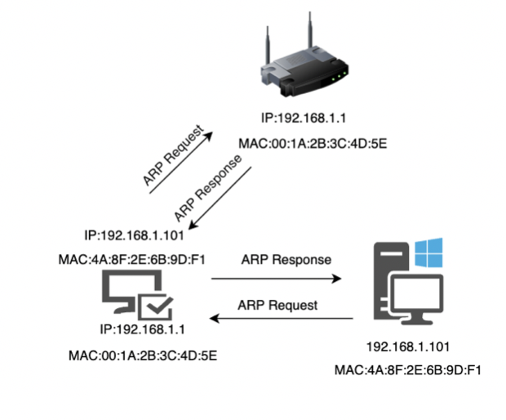
ARP poisoning

Slide 7
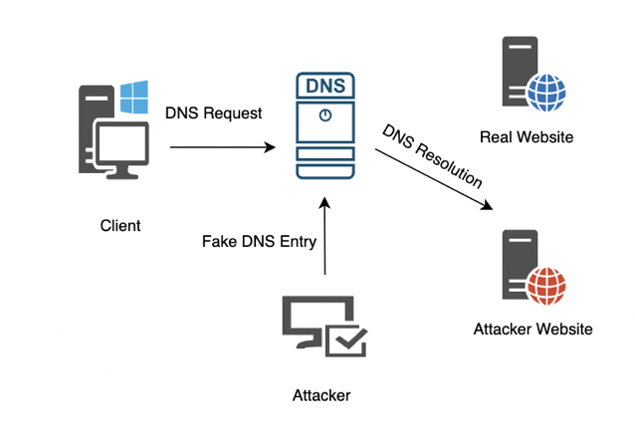
DNS Cache Poisoning

Slide 8
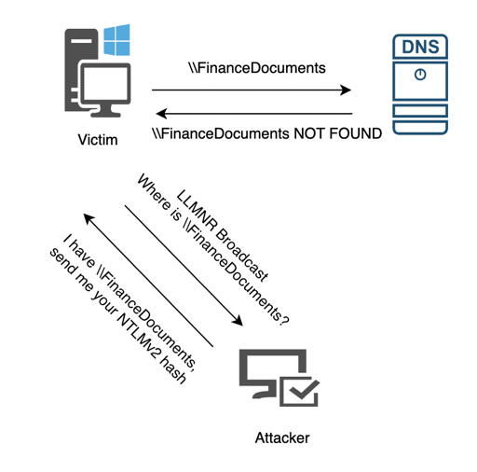
Link Local multicast name resolution(LLMNR)Poisoning

Slide 9
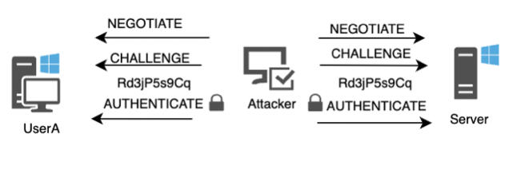
NTLM Relay attack
Intercept authentication attempts using NTLM(hash and username)
Relay to other systems to gain unauthorized access

Slide 10
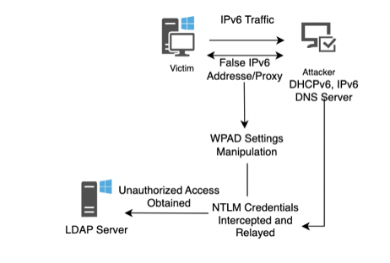
IPv6 DNS Takeover

Slide 11
Soc Tools
PURPOSE
COMMON SOC TOOLS
Security Information Event Management(SIEM)
IDS/IPS
Endpoint Detection and Response
Continuously monitor network traffic
Detect and analyze security incidents
Respond to mitigate threats
LIMITATIONS
Accuracy, rely on automated detection mechanisms(false positives/false negatives)
Scalability, managing extensive network structures
Adaptability, may be overwhelming for SOC analysts

Slide 12
Red Team engagements
WHAT?
GOAL
Unveil severe network vulnerabilities
Challenge an organizations defenses to reveal areas of improvement
Challenge SOC's ability to identify, detect, and mitigate threats
Simulate real world cyber attacks
Proactive approach to identifying vulnerabilities in an organizations network
HOW?
Emulating Tactics, Techniques, and Procedures of real-world Adversaries
Engagements often include AD MitM attack scenarios

Slide 13
Design and methodology
NETWORK DESIGN
AD Internal network design
VPS and Dropbox Connectivity
Cloud SIEM and SOC integrations setup
VARIABLES AND METRICS
Independent variable , dependent variable, hypothesis
MITM ATTACK DEMO
LLMNR Poisoning, NTLM Relay Attack, and IPV6 DNS Takeover via LAN Turtle and Raspberry Pi dropbox devices

Slide 14
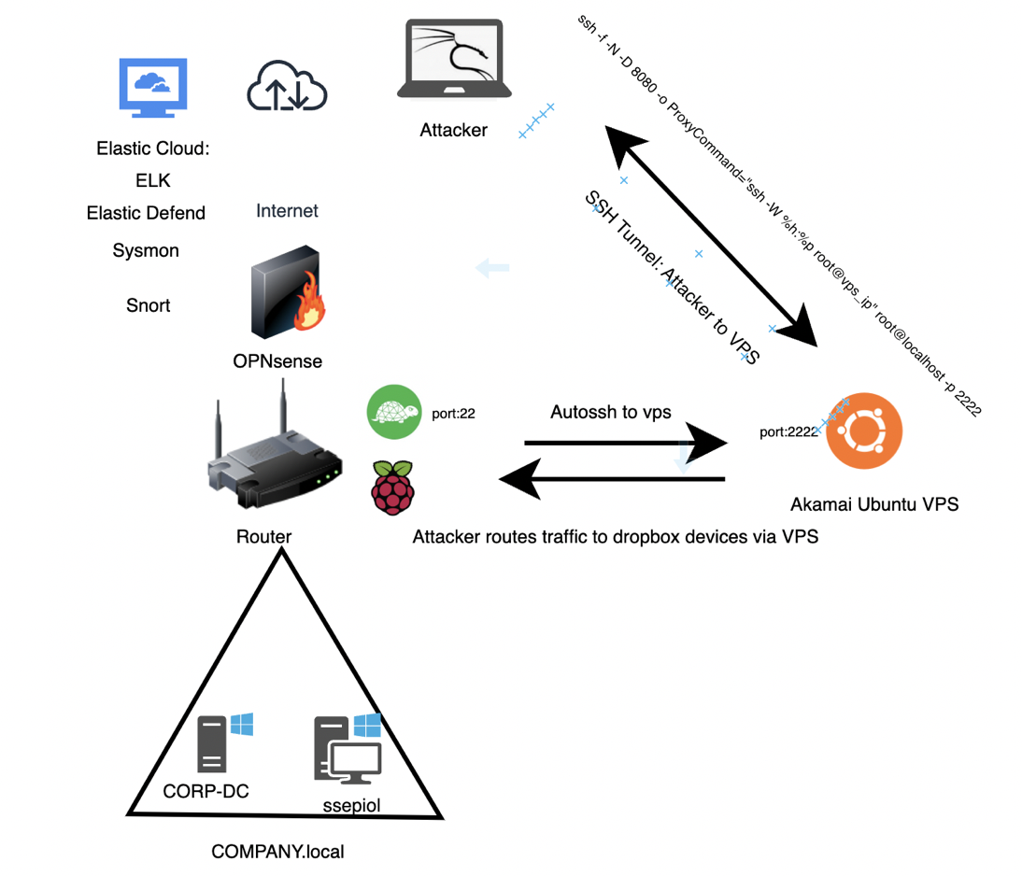
Network Design
20XX

Slide 15

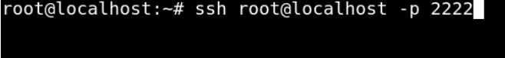
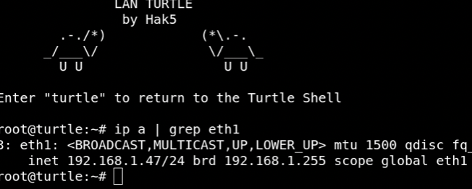
Dropbox Connectivity: LAN Turtle
SSH from the attack machine to the VPS
SSH from the VPS to the LAN Turtle
Internal Network CIDR

Slide 16
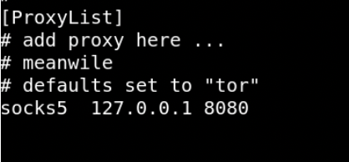
Alternate connectivity: Routing traffic using socks proxy
/etc/proxychains.conf
SSH one liner routing attack machine traffic through VPS to the LAN Turtle

Slide 17
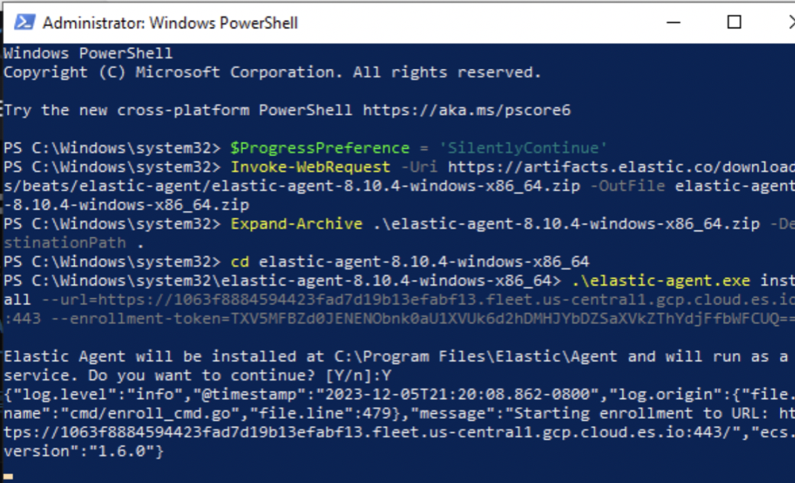
Elastic cloud siem: Elastic Agent/defend setup
Elastic Agent Installation on AD Windows Machine

Slide 18
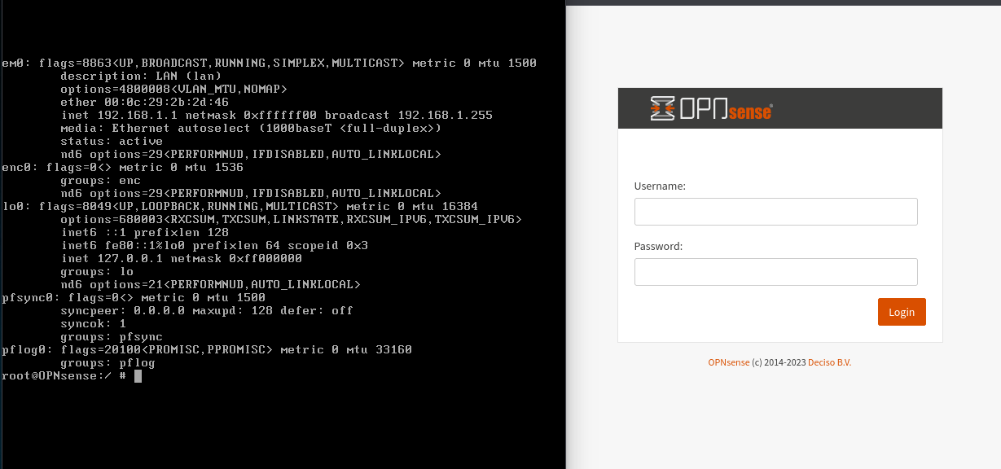
Elastic cloud siem: opnsense installation

Slide 19
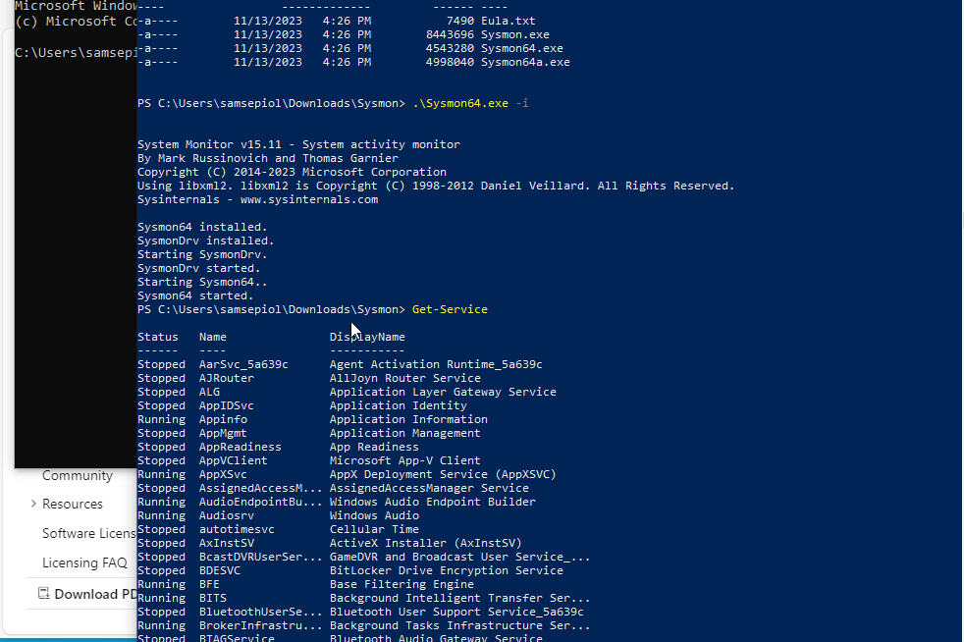
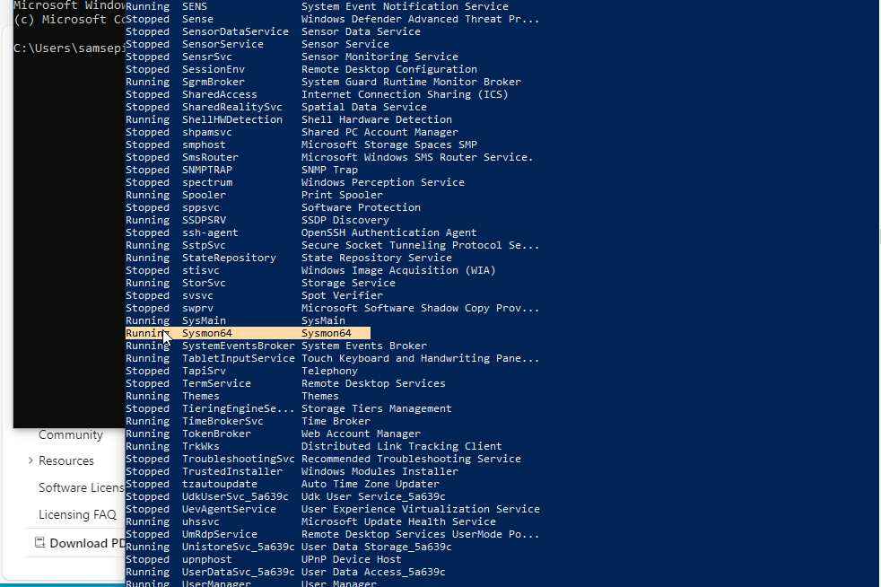
Elastic cloud siem: sysmon installation

Slide 20
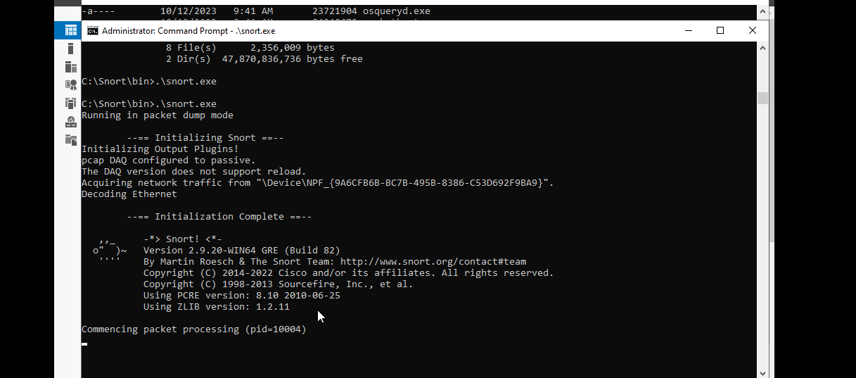
Elastic cloud siem: SNORT Installation

Slide 21
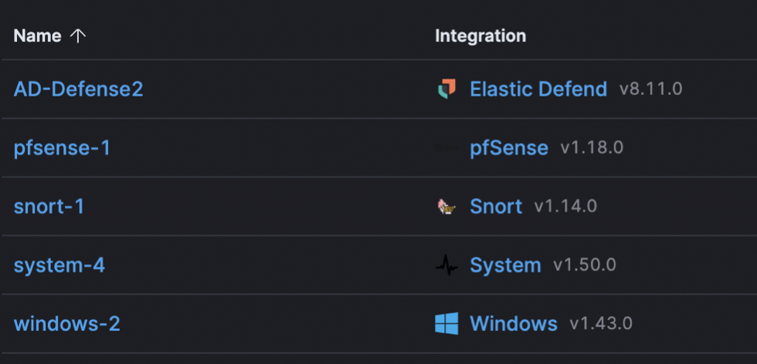
Elastic cloud siem: SOC integrations
Policy integrations for AD agents
PfSense integration includes OPNsense support

Slide 22
Independent and dependent variables
INDEPENDENT VARIABLE
Attack types of MitM devices
DEPENDENT VARIABLES
Evasion effectiveness and success rates of MitM Attacks

Slide 23
Hypothesis
SUCCESS RATES OF ATTACKS AMONG DROPBOX DEVICES
H0: no inconsistency among success rates for different attacks
H1: some inconsistency among success rates of different attacks
​
DETECTION RATES EFFECTIVENESS​ OF SOC TOOLS
H0: no varying level of effectiveness in SOC tools in detecting MitM attacks across different dropbox devices
H1: SOC tools exhibit varying levels of effectiveness in detecting MitM attacks across different dropbox devices
EFFECTIVENESS OF DROPBOX DEVICES
H0: No significant difference between success rates of MitM attacks between the LAN Turtle and Raspberry Pi 4
H1: There is a significant difference between success rates of MitM attacks between the LAN Turtle and Raspberry Pi. 4
​

Slide 24
Demo

Slide 25
LLMNR POISONING

Slide 26
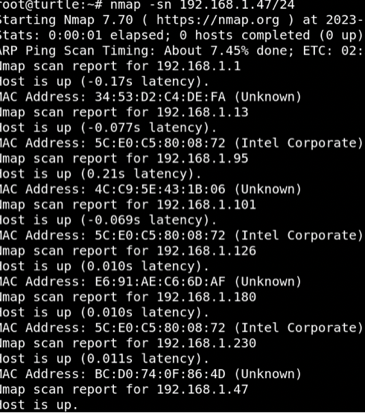
Host Discovery Using nmap

Slide 27
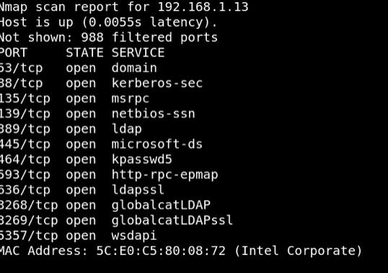
2. CORP-DC PORT SCAN

Slide 28
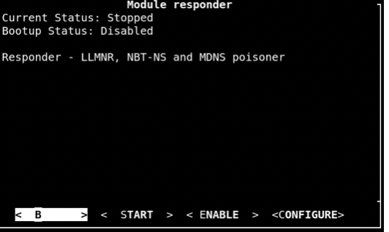
3. LAN Turtle Responder module

Slide 29
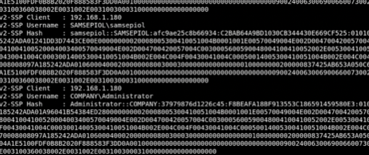
4. Capture hashes

Slide 30
NTLM RELAY ATTACK

Slide 31
1.ntlmrelayx.py used with responder

Slide 32
2. Connection received from user ssepiol

Slide 33
IPv6 DNS Takeover

Slide 34
1.Start ntlmrelayx.py specifying Dc ip and fake wpad proxy

Slide 35

2.Start mitm6 specifying domain company.local

Slide 36
3.NTLMv2 hashes captured

Slide 37
Detection

Slide 38
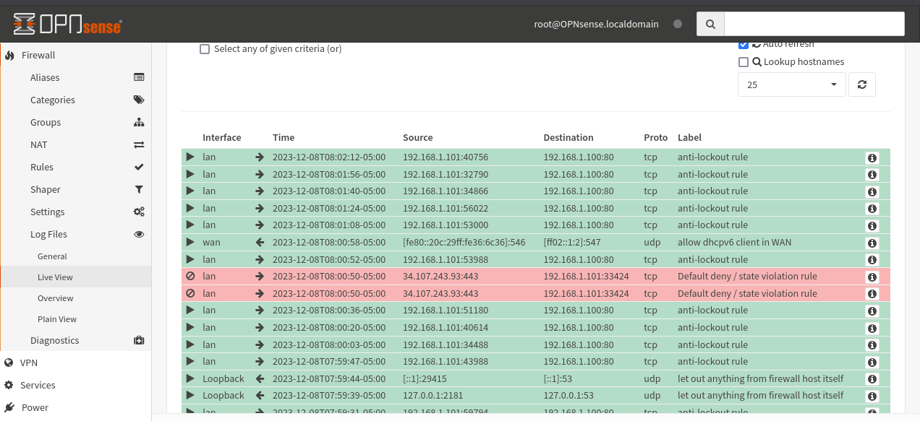
DEtection: OPNsense

Slide 39
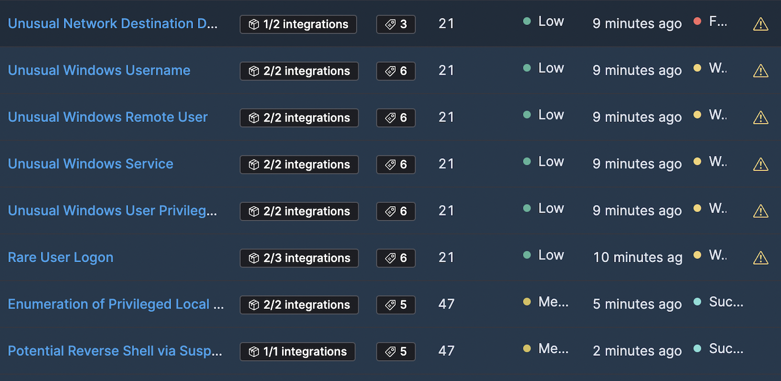
DEtection: ELK Stack

Slide 40
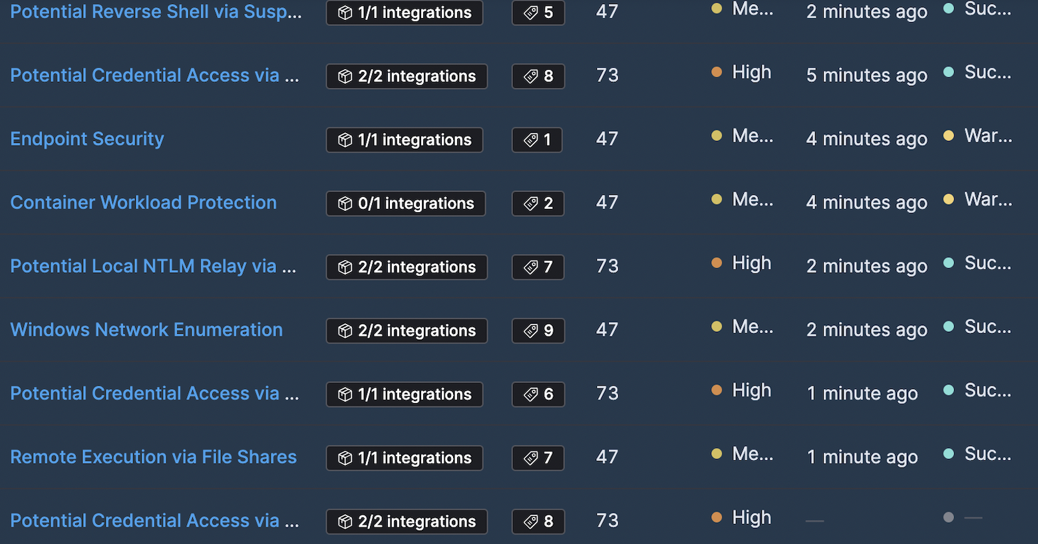
DEtection: ELK Stack

Slide 41
Results: Data collection and analysis
STANDARD DEVIATION OF SUCCESS RATES
Measures amount of variability among the success rates of different attack types
H0: No inconsistency among success rates for different attacks
H1: some inconsistency among success rates of different attacks
STANDARD DEVIATION OF DETECTION PERCENTAGES
Measures variability among percentages of successful detection by SOC tools for different devices
H0: no varying level of effectiveness in SOC tools in detecting MitM attacks across different dropbox devices
H1: SOC tools exhibit varying levels of effectiveness in detecting MitM attacks across different dropbox devices

Slide 42
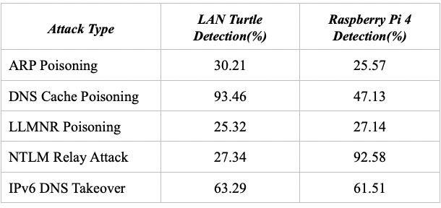
Table 1: Detection by SOC tools

Slide 43
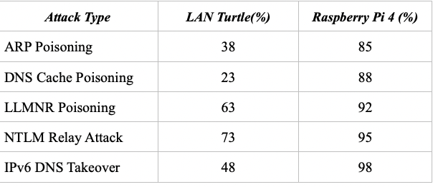
Table 2: Attack success rates

Slide 44
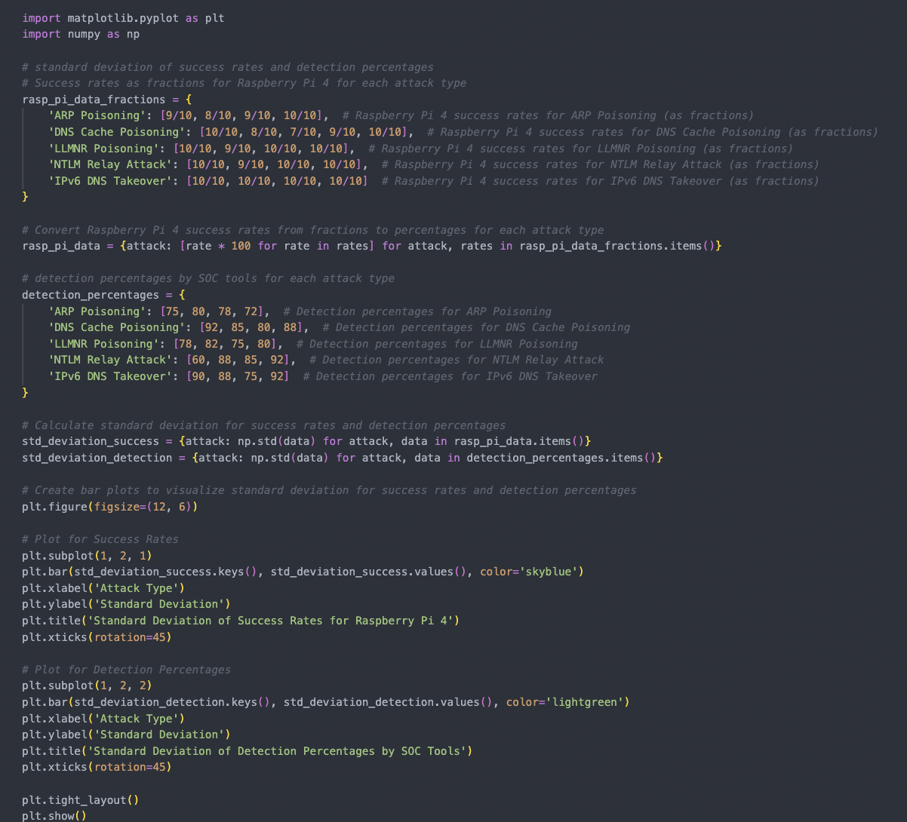
std_dev.ipynb
Utilizes success rates and detection rates for both the LAN Turtle and Raspberry Pi 4

Slide 45
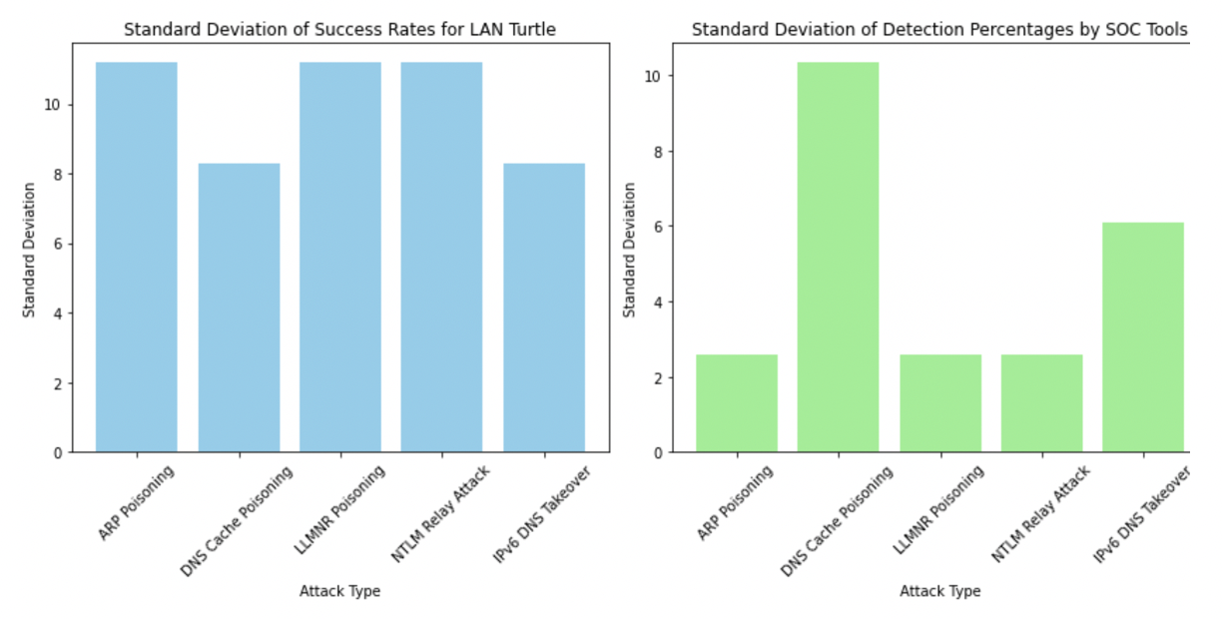
Descriptive Statistics: LAN Turtle
Standard Deviation of Success Rates and Detection Percentages by SOC tools for the LAN Turtle
Large Std Dev: inconsistency among success rates of different attacks used on the LAN Turtle
Smaller Std Dev: consistency in effectiveness of SOC tools in detecting attacks on the LAN Turtle

Slide 46
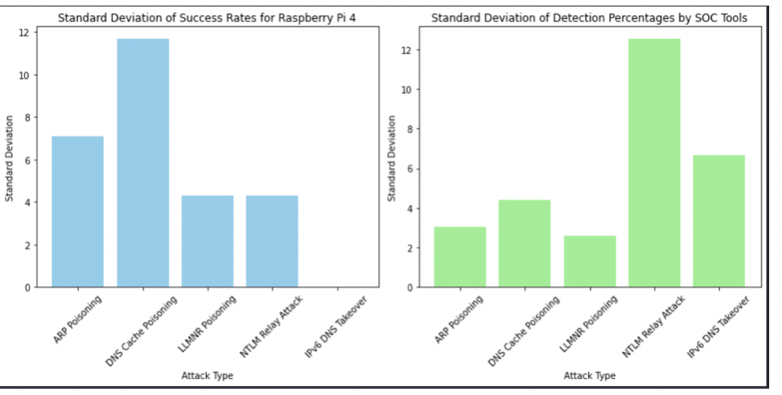
Descriptive Statistics: Raspberry pi 4
Standard Deviation of Success Rates and Detection Percentages by SOC tools for the Raspberry Pi
Smaller Std Dev: consistency among success rates of different attacks used on the Raspberry Pi 4
Large Std Dev: inconsistency in the effectiveness of SOC tools in detecting the attack on the Raspberry Pi 4

Slide 47
T-tests
Used to compare the mean success rates between the LAN Turtle and Raspberry Pi 4 for all attack types
Interpretation: indicates whether a significant difference exists regarding the success rates of MitM attacks between the LAN Turtle and Raspberry Pi 4

Slide 48
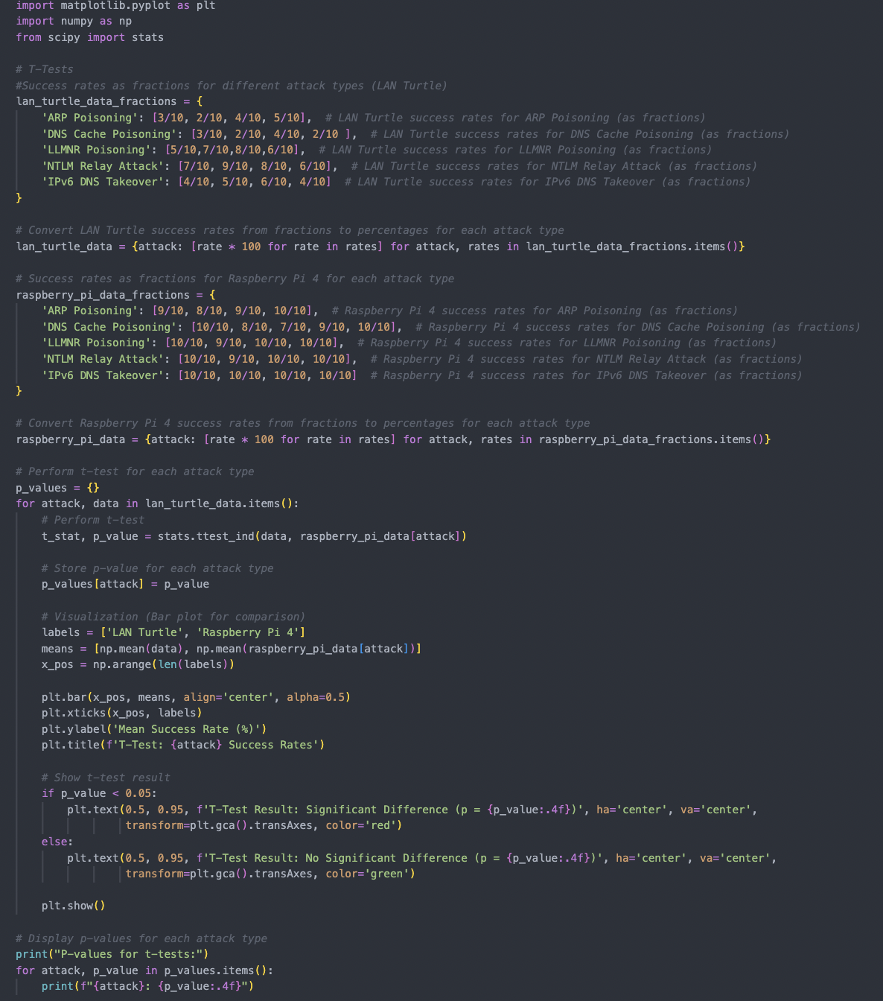
t-tests.ipynb
Utilizes Success Rates for both the LAN Turtle and Raspberry Pi 4
20XX

Slide 49
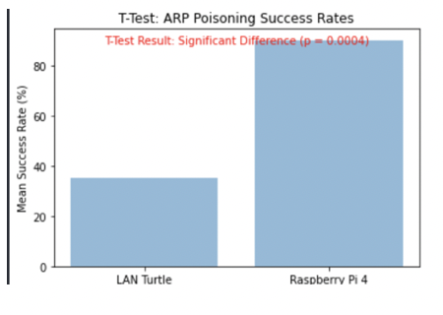
T-tests: ARP Poisoning success rates
Significant difference between the success rates of MitM attacks between the LAN Turtle and Raspberry Pi 4
Recall: consistency in success rates among Raspberry Pi 4, inconsistency in SOC tools detecting attacks from the Raspberry Pi 4

Slide 50
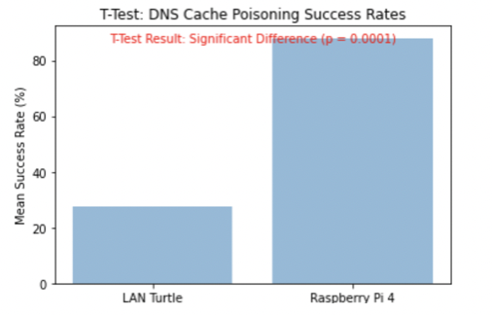
T-tests: DNS cache poisoning success rates
Significant difference between the success rates of MitM attacks between the LAN Turtle and Raspberry Pi 4
Recall: consistency in success rates among Raspberry Pi 4, inconsistency in SOC tools detecting attacks from the Raspberry Pi 4

Slide 51
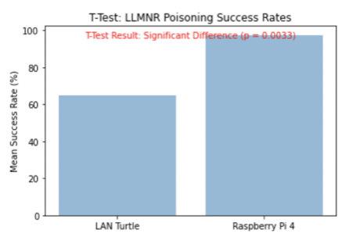
T-tests: llmnr poisoning success rates
Significant difference between the success rates of MitM attacks between the LAN Turtle and Raspberry Pi 4
Recall: consistency in success rates among Raspberry Pi 4, inconsistency in SOC tools detecting attacks from the Raspberry Pi 4

Slide 52
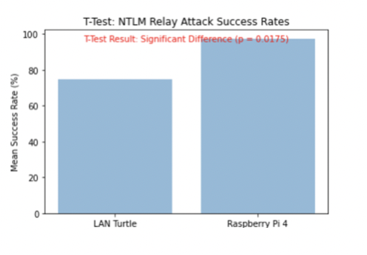
T-tests: NTLM Relay Attack success rates
Significant difference between the success rates of MitM attacks between the LAN Turtle and Raspberry Pi 4
Recall: consistency in success rates among Raspberry Pi 4, inconsistency in SOC tools detecting attacks from the Raspberry Pi 4

Slide 53
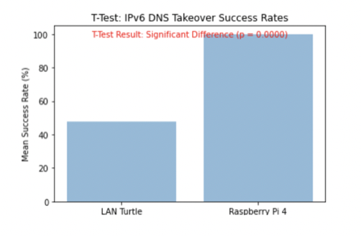
T-tests: IPv6 DNS takeover success rates
Significant difference between the success rates of MitM attacks between the LAN Turtle and Raspberry Pi 4
Recall: consistency in success rates among Raspberry Pi 4, inconsistency in SOC tools detecting attacks from the Raspberry Pi 4

Slide 54
Conclusion
This research provided practical insights into the effectiveness of MitM attacks against SOC tools, bridging the gap between red team engagement strategies utilizing Dropbox devices and the efficiency of SOC tools.

Slide 55
THANK YOU
Aziel Orozco
Aaoroz9881@ung.edu

